Slide 1
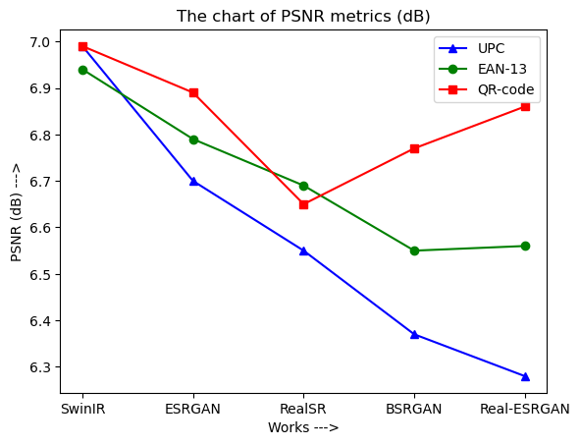
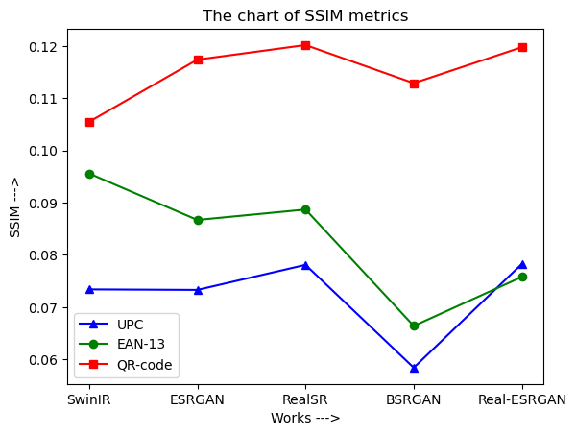
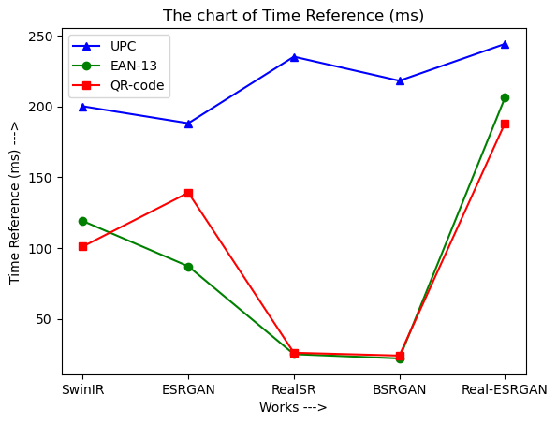
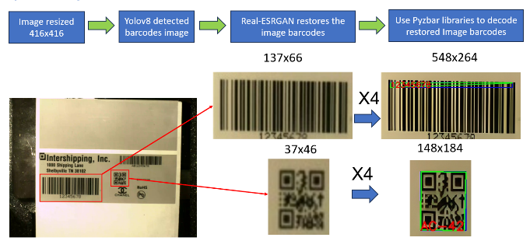
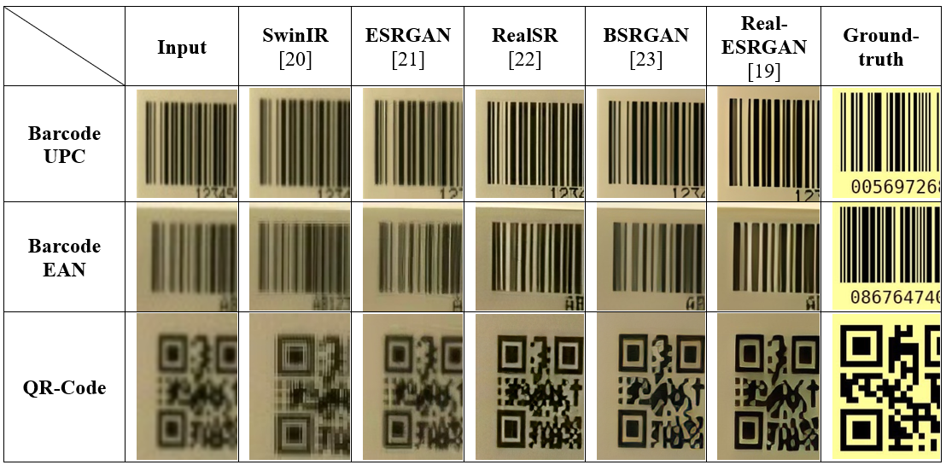
Ministry of Science and Technology Project Name: | Decoding Barcode Images with YOLOv8 and REAL-ESRGAN
Ministry of Science and Technology Project Number: | NSTC-112-2221-E-992-045, NSTC-112-2221-E-992-057-MY3 NSTC-112-2622-8992-009-TD1.
Project host: | Van-Tuan Tran*, Mong-Fong Horng, Chin-Shiuh Shieh
Project participants: | Prasun Chakrabarti
Execution agency: | Department of Electronic Engineering, National Kaohsiung University of Science and Technology
Abstract
Barcodes have long been an indispensable part of modern trade and logistics, allowing for the effective tracking and identification of products and packages for a long time, and have become a popular standard for production management. , but in industrial factories, depending on superior requirements, we can create an integrated barcode reader combined with other functions using the resources available with their cameras. This study explores a new approach to decoding barcode images, leveraging the capabilities of YOLOv8 [18], an advanced object detection model, and REAL-ESRGAN [19], a state-of-the-art image processing method for super-resolution images. The main objective of this study is to demonstrate the feasibility and effectiveness of using YOLOv8 to locate and extract barcodes from complex scenes and the REAL-ESRGAN method to improve barcode images, increasing successful decoding accuracy and finally conducting a comparative survey of super-resolution methods applied with barcode images. This summary serves as the basis for an evaluation study of super-resolution methods, with potential implications for enhancing barcode-based systems in various real-world scenarios.
1. System architecture
The system's workflow was designed in 4 steps as follows, including the following technologies and libraries:
1-Image resized: we use the Opencv2 open-source library to resize the image, aiming to make the input image the same size as the size of the data set used to train the YOLOv8 model. At the same time, it is also to ensure processing speed when sending images through the model, specifically here we set the image to a size of 416x416.
2-Barcode localization: We use YOLOv8 to identify barcode regions in images. YOLOv8's real-time object detection enables accurate identification of barcode regions in images, even in challenging environments.
3-Barcode restoration: We use REAL-ESRGAN to enhance the quality and readability of barcode images. The image super-resolution ability of REAL-ESRGAN can greatly improve the clarity of barcode images, It can be said that it almost restores the barcode image to its original state, this is to maximize accuracy when decoding barcode images.
4-Decode barcode images: We use Pyzbar. This is an open source library for reading barcodes and QR codes. Its advantages are ease of use, high accuracy and fast response time. Its disadvantage is that it cannot work with blurry, noisy images and changing environmental.
Figure 3: Compare the calculated metrics with the ground truth image
When looking at the metrics evaluation, we see that the PSNR index of the models when compared to the ground-truth image is all below 20. The SSIM index is all below 0.2, although these indices are really low compared to the ground-truth image, so these methods still need to improve in terms of algorithms as well as training data in the future. But c we an see that the Real-ESRGAN [19] method has the best image recovery ability among all the remaining methods.
Figure. 1. System work flow on practical data
3. Conclusion
Even in complete environments with varying lighting conditions, YOLOv8 was able to display outstanding accuracy, underscoring its effectiveness in barcode positioning. Testing shows REAL-ESRGAN's excellent ability to improve the quality and readability of barcode images as well as REAL-ESRGAN's ability to decode super-resolution images. Significantly improves the clarity and fidelity of displayed barcodes. The final step is to decode the barcode using Pyzbar. Although Pyzbar can reduce steps in such problems, our integrated approach exploits the strengths of both YOLOv8 and REAL-ESRGAN to overcome these formulations and achieve a level of reliability and application. This application can be developed at industrial factories.
2. Experiments
The experiment highlights the robustness of our system, the results show that REAL-ESRGAN improved the quality of barcode images, effectively restoring them to their original state as Figure 3.
Figure 2: Compare the calculated metrics with the ground truth image

